Slide 1
Optical Fiber Communications — chapter03— Transmission characteristics of optical fibers

Slide 2
Attenuation
The attenuation or transmission loss of optical
fibers has proved to be one of the most important
factors in bringing about their wide acceptance in
telecommunications.
As channel attenuation largely determined the
maximum transmission distance prior to signal
restoration,
optical fiber communications became especially
attractive when the transmission losses of fibers were
reduced below those of the competing metallic conductors
(less than 5 dB km−1)

Slide 3

Attenuation
Signal attenuation within optical fibers, as with
metallic conductors, is usually expressed in the
logarithmic unit of the decibel.
The decibel, which is used for comparing two power
levels, may be defined for a particular optical
wavelength as the ratio of the input (transmitted)
optical power P_{i} into a fiber to the output (received)
optical power P_{o} from the fiber as:

Slide 4

Attenuation
This logarithmic unit has the advantage that the
operations of multiplication and division reduce to
addition and subtraction, while powers and roots
reduce to multiplication and division.
However, addition and subtraction require a
conversion to numerical values which may be
obtained using the relationship:

Slide 5

Attenuation
In optical fiber communications the attenuation is
usually expressed in decibels per unit length
(i.e. dB km−1) following:
where α_{dB} is the signal attenuation per unit length in
decibels which is also referred to as the fiber loss
parameter and L is the fiber length.

Slide 6
Attenuation
A number of mechanisms are responsible for the
signal attenuation within optical fibers.
These mechanisms are influenced by
the material composition ,
the preparation and
purification technique, and
the waveguide structure.

Slide 7
Attenuation
They may be categorized within several major
areas which include
material absorption,
material scattering (linear and nonlinear scattering),
curve and microbending losses,
mode coupling radiation losses and
Losses due to leaky modes.
There are also losses at connectors and splices
(সংযুক্ত করান), as illustrated in Example 3.1.

Slide 8
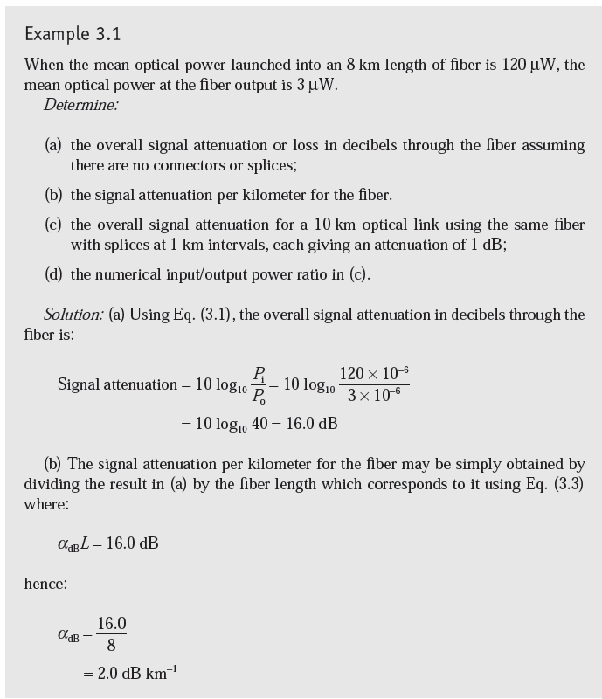
Data Mining: Concepts and Techniques

Slide 9
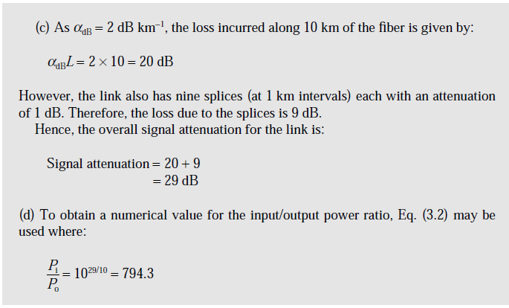
Data Mining: Concepts and Techniques

Slide 10
Material absorption losses in silica glass fibers
Material absorption is a loss mechanism related to the material composition and the fabrication process for the fiber, which results in the dissipation(অপচয়) of some of the transmitted optical power as heat in the waveguide.
The absorption of the light may be
intrinsic (caused by the interaction with one or more of the major components of the glass) or
extrinsic (caused by impurities within the glass).

Slide 11
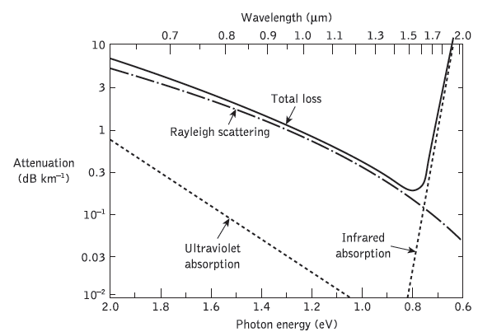
The attenuation spectra for the intrinsic loss mechanisms in pure GeO2–SiO2 glass
Infrared radiation, or simply infrared or IR, is electromagnetic radiation (EMR) with longer wavelengths than those of visible light
The electronvolt is a unit of energy equal to approximately 1.6×10⁻¹⁹ joules
Ultraviolet (UV) is an electromanetic radiation with a wavelength from 10 nm to 400 nm, shorter than that of visible light but longer than X-rays

Slide 12
Extrinsic absorption
In practical optical, fibers prepared by conventional
melting techniques
A major source of signal attenuation is extrinsic
absorption from transition metal element impurities.

Slide 13
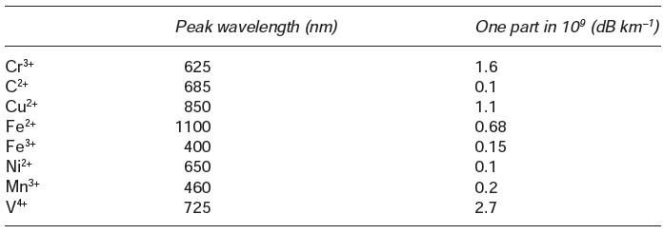
Absorption losses caused by some of the more common metallic icon impurities in glasses, together with the absorption peak wavelength
It may be noted that certain of these impurities, namely chromium and copper, in their worst valence state can cause attenuation in excess of 1 dB km−1 in the near-infrared region
Valence is generally understood to be the number of chemical bonds that each atom of a given chemical element typically forms.

Slide 14
Extrinsic absorption
Another major extrinsic loss mechanism is caused
by absorption due to water (as the hydroxyl or OH ion)
dissolved (দ্রবীভূত) in the glass.
These hydroxyl groups are bonded into the glass
structure and have fundamental stretching vibrations
which occur at wavelengths between 2.7 and 4.2 μm
depending on group position in the glass network.

Slide 15
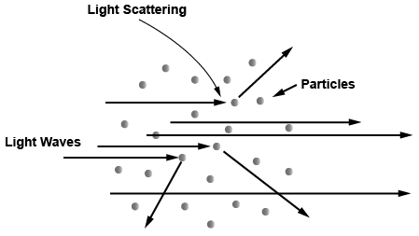
Linear scattering losses
Linear scattering mechanisms cause the transfer of some or all of the optical power contained within one propagating mode to be transferred linearly into a different mode.
This process tends to result in attenuation of the transmitted light as the transfer may be to a leaky or radiation mode which does not continue to propagate within the fiber core, but is radiated from the fiber.
Data Mining: Concepts and Techniques

Slide 16
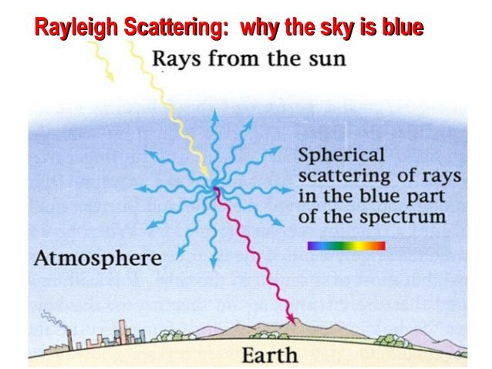
Rayleigh scattering
Rayleigh is the elastic scattering of light or other electromagnetic radiation by particles much smaller than the wavelength of the radiation.
The particles may be individual atoms or molecules
Data Mining: Concepts and Techniques

Slide 17
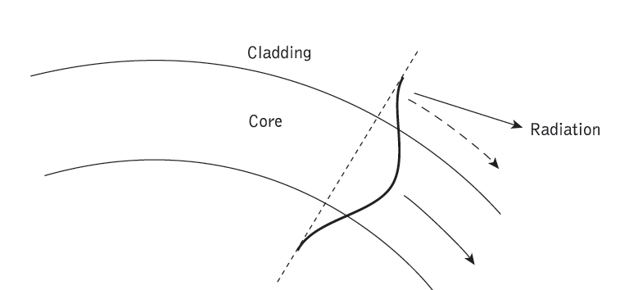
Fiber bend loss
Optical fibers suffer radiation losses at bends or curves on their paths.
This is due to the energy in the evanescent(বিলীয়মান) field at the bend exceeding the velocity of light in the cladding and hence the guidance mechanism is inhibited, which causes light energy to be radiated from the fiber.
Data Mining: Concepts and Techniques

Slide 18
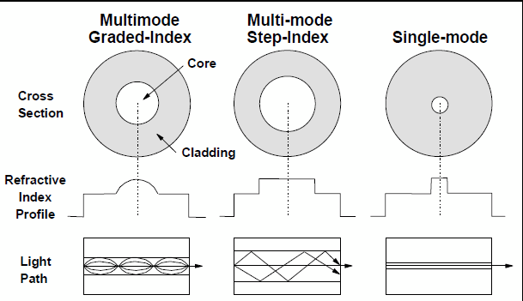
Different mode fiber

Slide 19
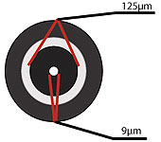
Single Mode Fiber Optic Cable
Single Mode fiber optic cable has a small diametral core that allows only one mode of light to propagate.
This application is typically used in long distance
Left: Single Mode fiber is usually 9/125 in construction. This means that the core to cladding diameter ratio is 9 microns to 125 microns.

Slide 20
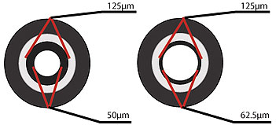
Multimode Fiber Optic Cable
Multimode fiber optic cable has a large diametral core that allows multiple modes of light to propagate.
Because of this, the number of light reflections created as the light passes through the core increases, creating the ability for more data to pass through at a given time.

Slide 21
Multimode Fiber Optic Cable
Because of the high dispersion and attenuation rate with this type of fiber, the quality of the signal is reduced over long distances.
This application is typically used for short distance, data and audio/video applications in LANs.
Multimode fiber is usually 50/125 and 62.5/125 in construction.
This means that the core to cladding diameter ratio is 50 microns to 125 microns and 62.5 microns to 125 microns.

Slide 22
Dispersion
Dispersion of the transmitted optical signal causes distortion for both digital and analog transmission along optical fibers.
Dispersion mechanisms within the fiber cause broadening of the transmitted light pulses as they travel along the channel.
The phenomenon is illustrated in Figure 3.7, where it may be observed that each pulse broadens and overlaps with its neighbors, eventually becoming indistinguishable at the receiver input.
Data Mining: Concepts and Techniques

Slide 23
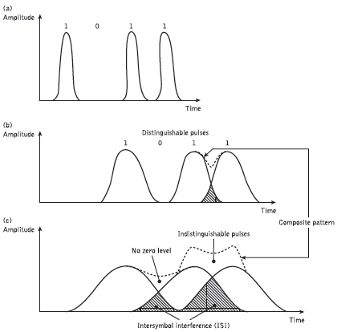
An illustration using digital bit pattern 1011: broadening of light pulses as they are transmitted along a fiber
:
(a) fiber input;
(b) fiber output at a distance L1;
(c) fiber output at a distance L2 > L1
Data Mining: Concepts and Techniques

